Slide 1

Scrapping and Segregation of Immigration Data from Reddit
DSCI 511
DATA ACQUISITION AND PREPROCESSING
Akshay Jain, Sunita Barik, Utsav Pradhan,
Partheepsiva Prasad
28th November 2022

Slide 2
Introduction & Purpose of Dataset
USA is home one fifth of the entire migrant populace(more than 40 million)
Main Origin Countries: Mexico(25%), China(6%) and India(6%)
Immigrants face varying issues and have differing scenarios
Identify major issues occurring in immigration process
Repository for understanding migration procedures
Educate the audience with potential issues
Educate the audience with respective solutions

Slide 3
Potential Users
Students
Families
Employees
Employers
Government Agencies
Educational Institutions

Slide 4
Source of Data
Reddit
The data was extracted from user posts in the "Immigration" subreddit (https://www.reddit.com/r/immigration).
Reddit allows public access through its various API’s, and we have utilized that feature.
Notes:
Photo reference: reddit.com

Slide 5
Approach to Acquiring the Data
Pushshift Reddit API
a. Posts:
https://api.pushshift.io/reddit/search/submisson
b. Comments:
https://api.pushshift.io/reddit/search/comment
Extracted all posts and comments between initialized date range.
To get around the 250-request limit, I iterated the function by increasing the initial time by 864000 seconds
Converted JSON into dataframe

Slide 6
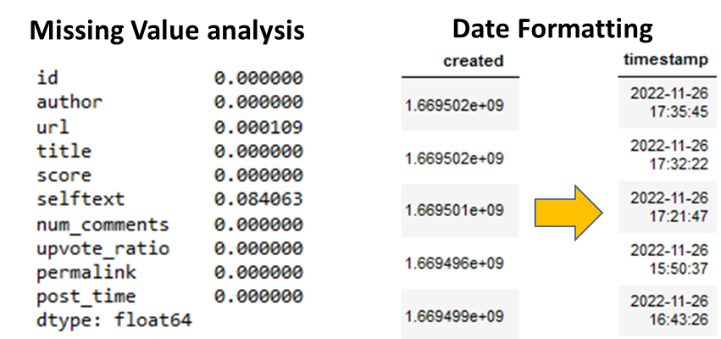
Approach to Data Preprocessing
Missing Value analysis:
The reddit data contained 0.08% of missing value.
Handling missing values: Drop rows with missing values
As the % missing data was negligible, we deleted the rows that had missing values
Data Formatting:
The raw data contained Unix time to data time
Feature selection and Data Segregation
Filtered the data on basis of number of comments and upvote ratio.

Slide 7
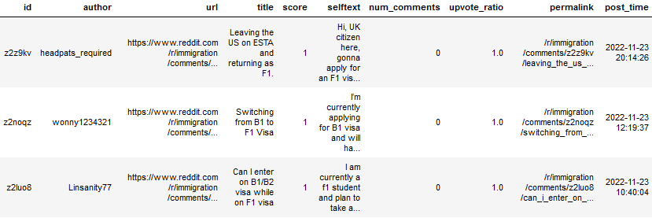
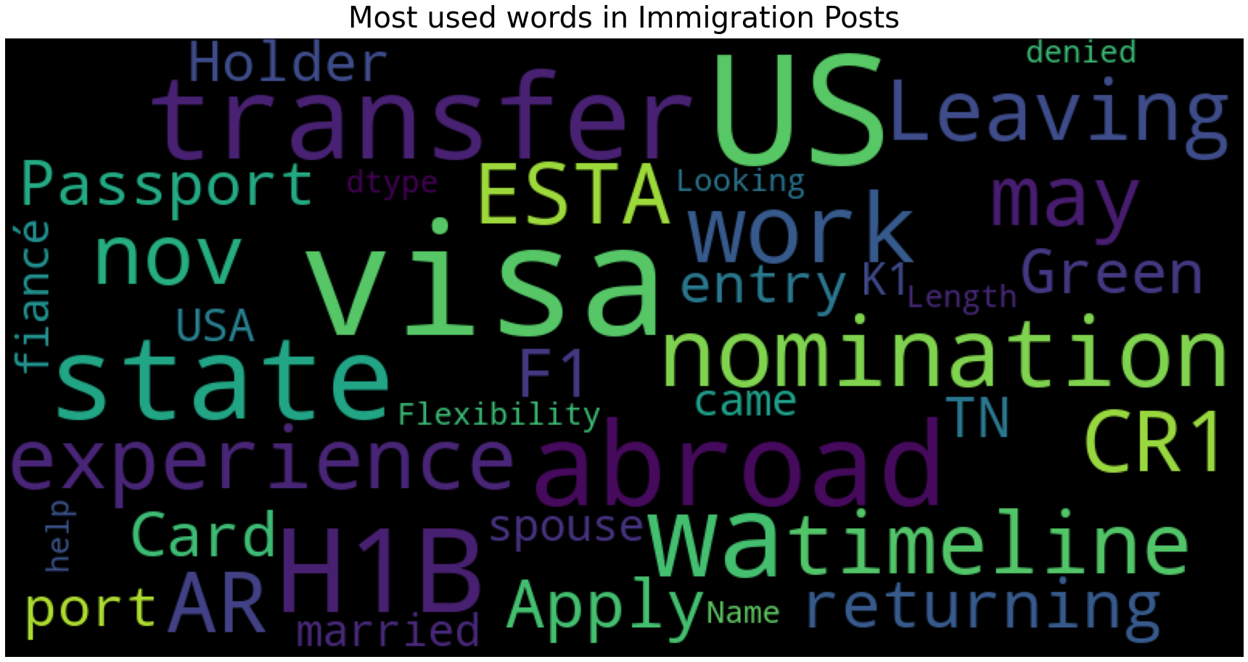
Distribution Approach
We distributed the data by considering the important keywords of immigration like H1B, F1, Green Card, Immigration, etc. and features like Number of Comments and Upvote Ratio.
Top commented posts.
Top upvoted posts.
All F1 visa related posts.
All H1B visa related posts.
All Green card related posts.
All Immigration related posts.
Word Cloud for most used words in posts.

Slide 8
Discussion of Access Rights
The data has been scrapped from a legal source: Reddit Website. Reddit's data is publicly available.
Praw: A Python wrapper for the official Reddit API. To collect data using PRAW, you will need a Reddit account. We need to register with Reddit as a developer to get an OAuth2 token
Pushshift: An independent API project built to improve upon the limits of the official API. It doesn’t require any authentication, so you will not need an API key to access the data.

Slide 9
Limitations & Issues
PRAW library could only extract 1000 posts
Only 250 extractions per request and code throws “JSONcodeError” randomly sometimes.
Loss in data extraction if we increment the time by a lot.
Can have lots of duplicates if incremental time is less.

Slide 10
Data Limitations & Challenges
Broad Spectrum of Users and Scenarios
Potential for Extreme Cases which might influence the audience
Solutions provided by users may not be applicable in general scenario
Could lead to loss of time or demotivating results
Dataset cannot be comprehensive enough to cater everyone's needs

Slide 11
Other Data Extraction Techniques
HTTP(with socket and regex): Although it is possible to send an HTTP request manually using a socket and parse the HTTP response using regular expression, there are higher-level APIs that can make this work simpler.
urllib3 & LXML: Urllib3 can handle requests like creating and managing pools and proxy pools, for example. Since Urllib3 is divided into several modules, it might not soon be included in the standard library. Certain fundamentals are difficult for Urllib3 to manage, such as the necessity to manually build headers and add requests in order to extract cookies.
Grequests: processes asynchronous Python APIs, which enables simultaneous processing of several requests. Small scripts benefit from this, while high level scrapping is less desirable.
Scrappy: several applications, such as sitemaps, multiple data processing, asynchronous web page downloads, etc. The drawback of scrappy is that it has a steep learning curve and requires a lot of learning, making it a dynamic approach for data extraction.

Slide 12
References
https://reddit-api.readthedocs.io/en/latest/
https://noelleferrari.medium.com/collecting-data-from-reddit-e019d1dece6a
https://www.reddit.com/r/immigration
https://www.pewresearch.org/fact-tank/2020/08/20/key-findings-about-u-s-immigrants/
https://www.scrapingbee.com/blog/web-scraping-101-with-python/
https://blog.apify.com/pros-and-cons-of-web-scraping/

Slide 13
Team & Contribution
Akshay Jain : Data Scrapping, Data Preprocessing, Presentation.
Sunita Barik : Data Scrapping, Data Preprocessing, Data Segregation, Presentation.
Utsav Pradhan : Research, Presentation.
Partheepsiva Prasad : Research, Analysis

Slide 14
Thank You !

